Slide 1
Firmware plan

Slide 2
Development plan
PID loop working
Modeling the motor
Analyzing
Control.

Slide 3
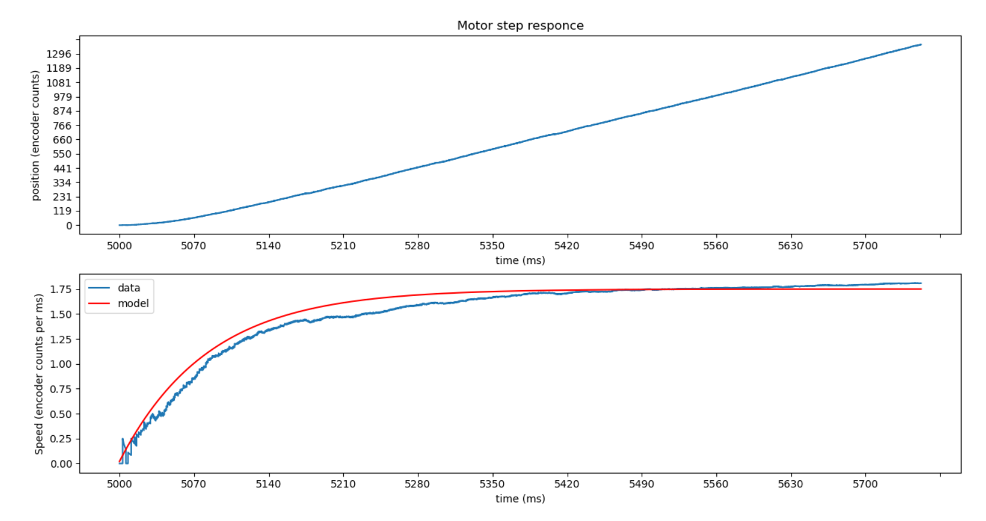
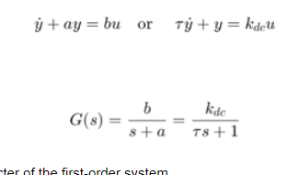
Y(t) = A(1 - e^{-t/T})
T =83
A = 1.75

Slide 4
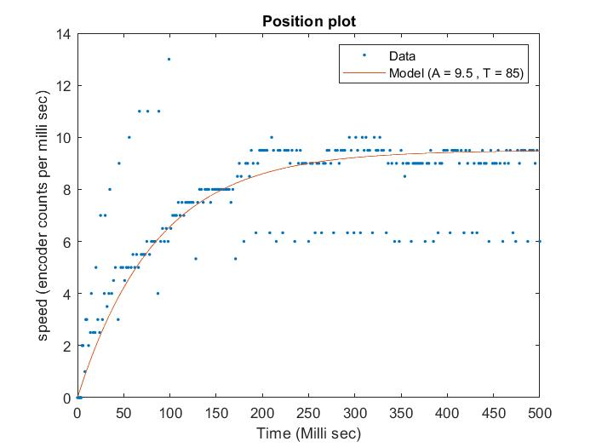

Slide 5
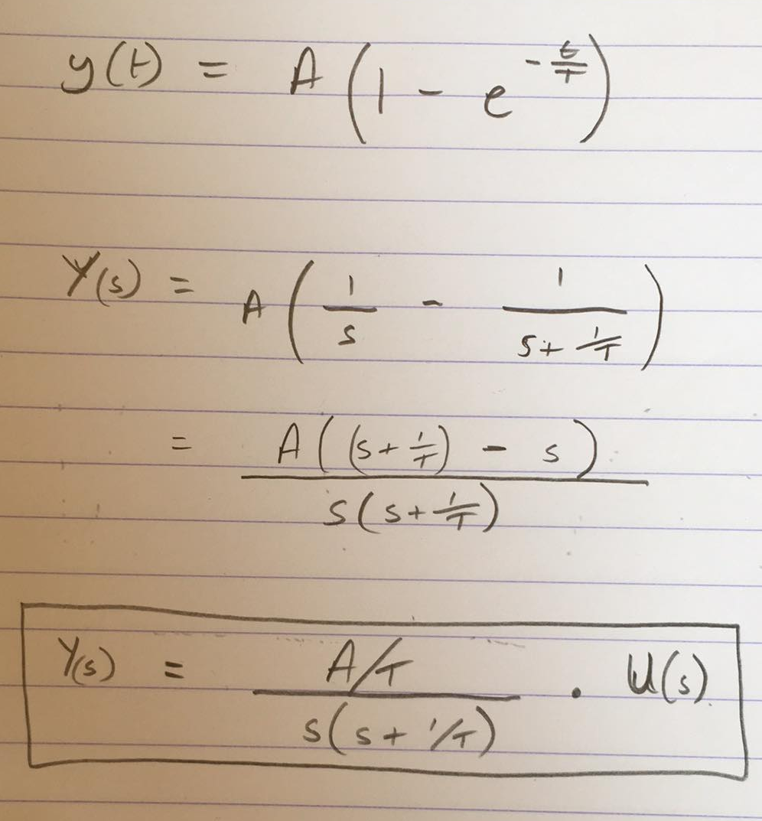

Slide 6
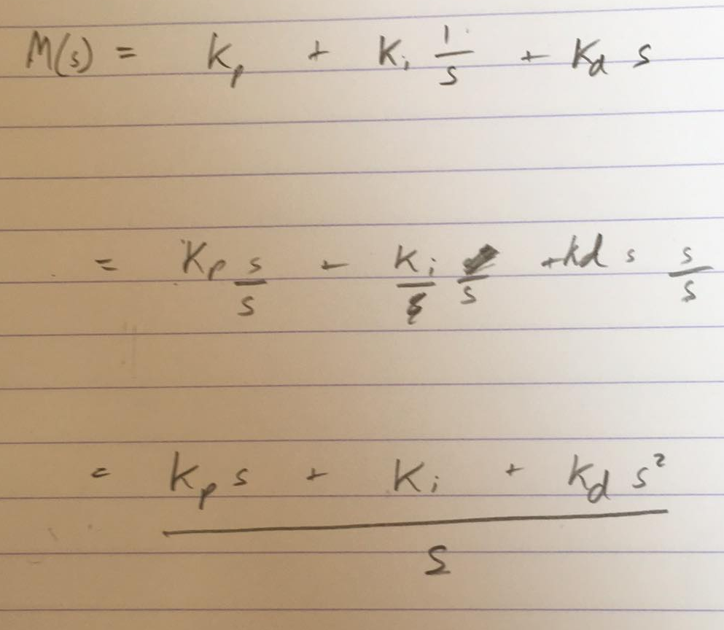
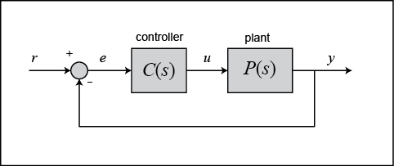

Slide 7
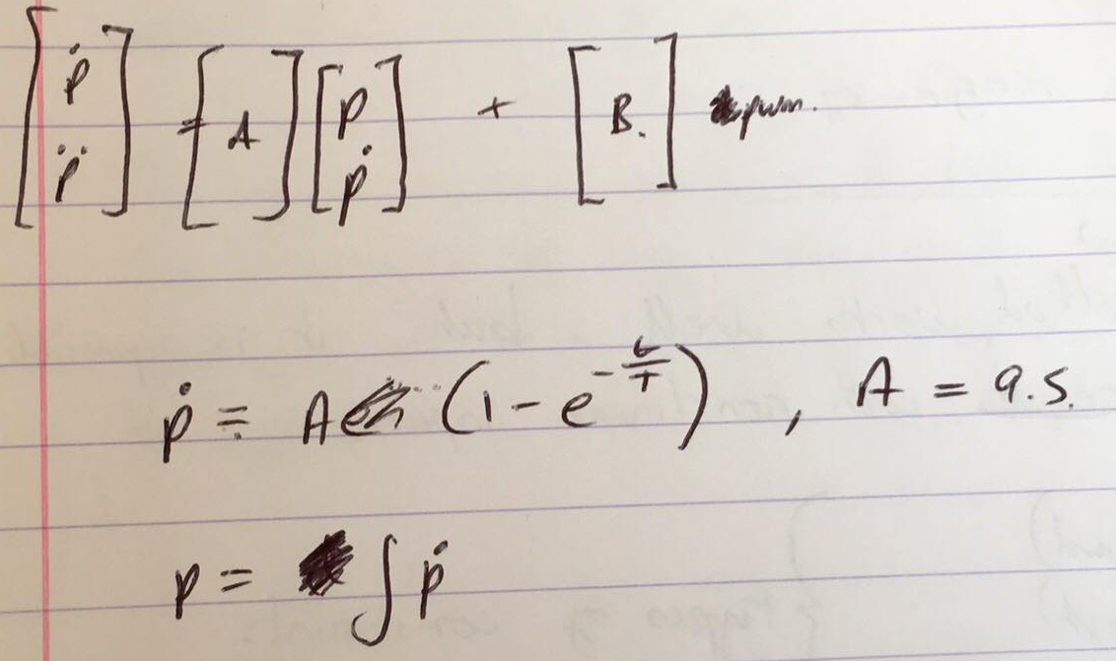
State space representation?
http://ctms.engin.umich.edu/CTMS/index.php?example=MotorPosition&section=ControlStateSpace
http://ctms.engin.umich.edu/CTMS/index.php?example=MotorSpeed&section=SystemModeling

Slide 8
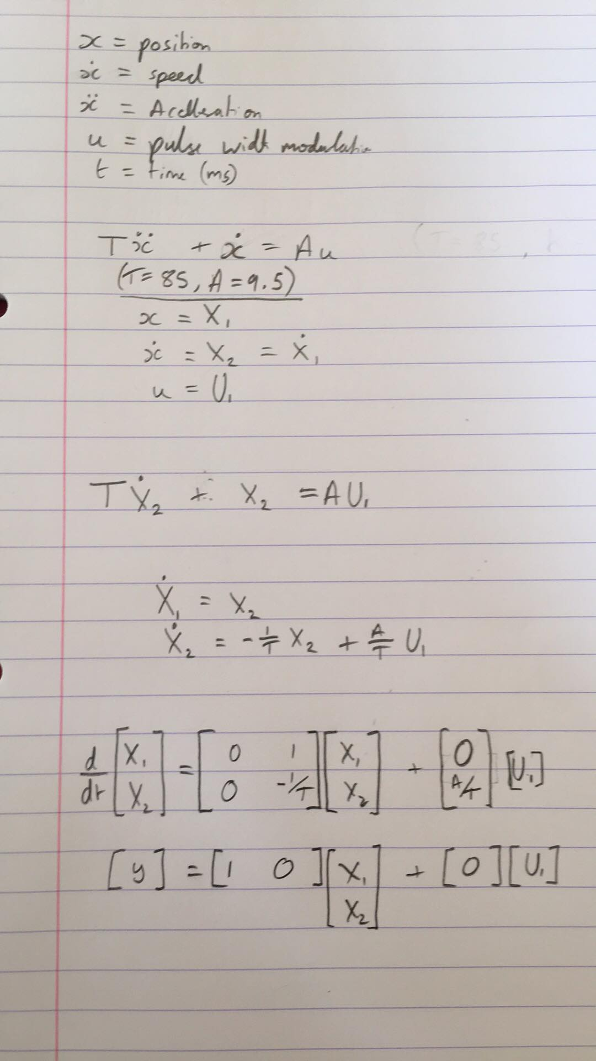
State space model.

Slide 9
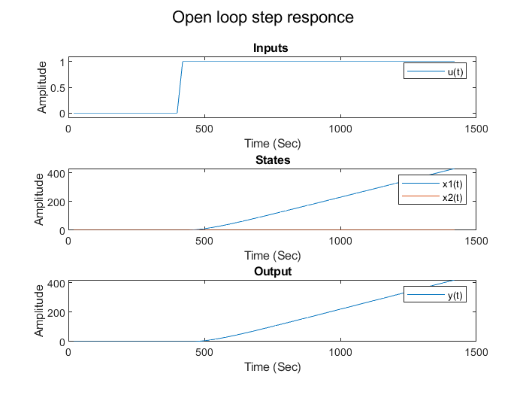
Open loop step response

Slide 10
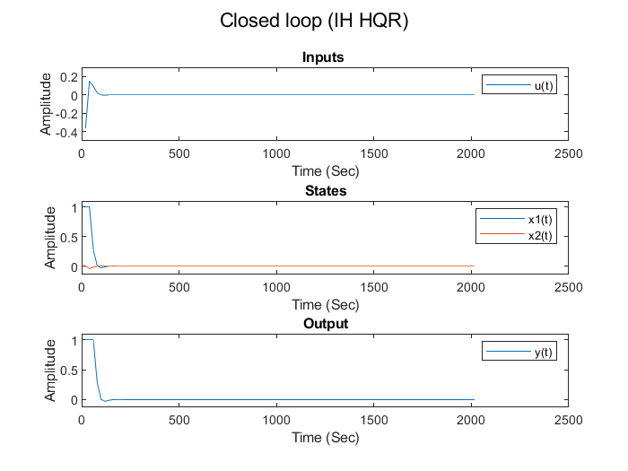
Closed loop IH LQR

